Slide 1
Global Diagnosis Education
coredentistry.com
© CORE Dentistry All Rights Reserved

Slide 2
CORE Presentation
This is an instruction slide.
It will not be shown in the presentation.
Microsoft Windows
This template is compatible with PowerPoint 2003 and PowerPoint 2007.
The template file is saved in a read only final format. This will ensure the original template is not overwritten. When you save the file you will be prompted to save changes under a different name. Rename the file and save in a location you will be able to find.

Slide 3
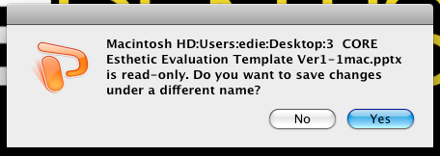
CORE Presentation
This is an instruction slide.
It will not be shown in the presentation.
Macintosh
This template is compatible with PowerPoint 2004 and PowerPoint 2008.
The template file is saved in a read only final format. This will ensure the original template is not overwritten. When you save the file you will be prompted to save changes under a different name. Rename the file and save in a location you will be able to find.

Slide 4
CORE Presentation
This is an instruction slide.
It will not be shown in the presentation.
Presentation Buttons
These buttons will navigate to the appropriate slide when clicked. They are only active when the Slide Show is running.

Slide 5
GDE Presentation
Doctor: Otten
Patient:
Age:
CC:
Dental Hx:

Slide 6
GDE Presentation
Medical Hx:Unremarkable
Social Hx:
Behavioral Style:

Slide 7
GDE Presentation
Patient objectives:
Patient concerns/barriers:
Budget considerations/defined amount? :

Slide 8
Full Face Repose
Full face repose picture
This is an instruction slide.
It will not be shown in the presentation.
To insert clinical pictures into the template, click on the Insert Picture box in the center of the box. The program will ask you to locate the file for importing. Once located, select the Insert button.

Slide 9
Global Diagnosis Form
Completed CORE Form
Put completed CORE form
Here

Slide 10
Occlusal Evaluation
Completed CORE Form
Put completed Occlusal form
Here

Slide 11
Full Face Repose
Full face repose picture
Incisal display
Lip symmetry
Facial Proportion
Facial Symmetry
Facial Flow

Slide 12
Full Face Smile
Full face smile picture
Midlines
Smile/Lip Symmetry
Buccal Corridor
Incisal Display
Gingival Display
Incisal/ Occlusal Planes

Slide 13
Full Face Retracted
Full face smile picture
Midlines
Incisal Display
Gingival Display
Incisal/ Occlusal Planes

Slide 14
Full Face Profile #1close up
Full face profile picture
Glabella to Facial of Maxillary Central
Facial Symmetry
Naso-labial angle

Slide 15
Full Face Profile #2 Head and neck
Full face profile picture
Head posture, normal/forward
Facial Symmetry

Slide 16
Middle Third Measurement
Middle third of face with caliper picture
Middle Third
?
mm

Slide 17
Lower Third Measurement
Lower third of face with caliper picture
Middle Third
?
mm
Lower Third
?
mm
CORE Value: Ratio 1:1

Slide 18
Upper Lip Length
Upper Lip
?
mm
Upper lip with caliper picture
CORE Value:
Female 20-22 mm
Male 22-24 mm

Slide 19
Lip Mobility
Close up incisal display in repose picture
Length of Central
?
mm
Central in Repose
_
?
mm
Gingival Exposed
+
?
mm
Lip Mobility
=
?
mm
Core Value: Lip Mobility 6-8 mm
Close up smile picture

Slide 20
Tooth
Presentation
Dental Midline
?
mm
?
(R/L)
Close up smile picture

Slide 21
Tooth
Presentation
Central in Repose
?
mm
Close up incisal display in repose picture

Slide 22
Smile Presentation
Gingival Line to Upper Lip
?
+/- mm
Distal Extent of Smile (Tooth #)
R
?
:
L
?
Buccal Corridors
?
Close up smile picture
Right
(OK/Excessive)
Left
?
(OK/Excessive)

Slide 23
Incisal Edge to Lower Lip
Incisal Edge to Lower Lip in FULL Smile
Close up smile picture
(Follows Smile Line, Covered by Lip, Reverse, Irregular)

Slide 24
Tooth Length
CORE Value:
Maxillary Canine 10.4
Maxillary Lateral 8.2
Maxillary Central 10.2
Intra-oral retracted picture

Slide 25
Height/Width Ratio
CORE Value:
Maxillary Canine 10.4
Maxillary Lateral 8.2
Maxillary Central 10.2
Ratio 1.2:1
Intra-oral retracted picture

Slide 26
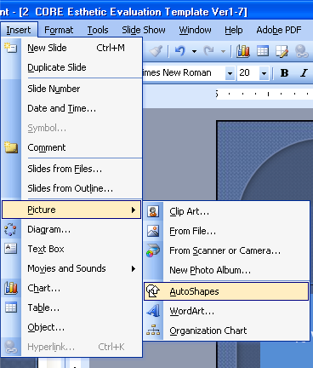
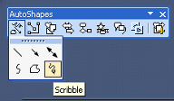
Tissue Levels
This is an instruction slide.
It will not be shown in the presentation.
To draw the gingival architecture on the picture in Windows PowerPoint 2003, select Insert → Picture → AutoShapes and then select the scribble button from the floating menu. Draw a rough estimate of the gums as shown on the left.

Slide 27
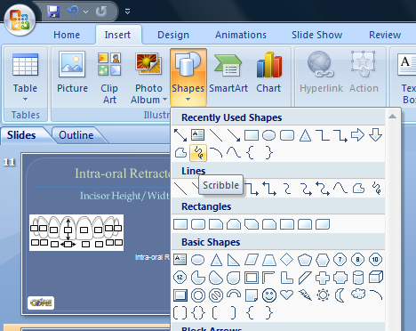
Tissue Levels
This is an instruction slide.
It will not be shown in the presentation.
To draw the gingival architecture on the picture in Windows PowerPoint 2007, select Insert, Shapes and then use the scribble button. Draw a rough estimate of the gums as shown on the left.

Slide 28
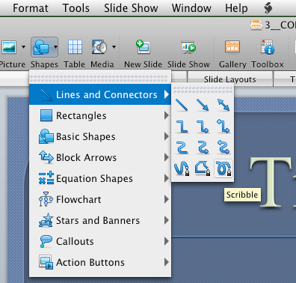
Tissue Levels
This is an instruction slide.
It will not be shown in the presentation.
To draw the gingival architecture on the picture in Macintosh PowerPoint 2008, select Shapes, Lines and Connectors and then the scribble button. Draw a rough estimate of the gums as shown on the left.

Slide 29
Tissue Levels
Intra-oral retracted picture

Slide 30
Tissue Levels
Intra-oral retracted picture with teeth apart to see lower teeth

Slide 31
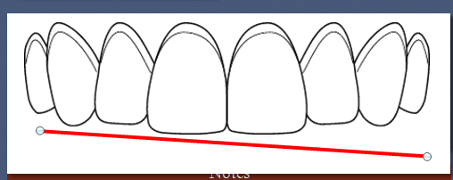
Angle of Incisal Plane
This is an instruction slide.
It will not be shown in the presentation.
Notes
Click to edit
Click on the line below the occlusal plane (the picture on the left on the next slide), grab the ends and adjust to simulate the incisal plane. You can practice with the line on the picture to the left.

Slide 32
Angle of Incisal Plane
Notes
Click to edit
Incisal Plane to Horizon

Slide 33
Posterior Plane
Posterior Occlusal Plane
Level
Step up R L
Step down R L
Angle down R L
Occlusal Plane to Horizon

Slide 34
Pathologic Tooth Wear
This is an instruction slide.
It will not be shown in the presentation.
Pathologic Wear
?
(Y/N)
Etiology
Add wear photos here
The X’s on the arches indicate wear, delete them where wear is not present.

Slide 35
Tooth Wear
Wear Yes/ No
Etiology

Slide 36
CEJ Located
This is an instruction slide.
It will not be shown in the presentation.
N
Y
N
Y
N
Y
N
Y
Click on box and place a Y (Yes) or a N (No) if you can locate the CEJ on the tooth.

Slide 37
CEJ Located
Intra-oral retracted picture

Slide 38
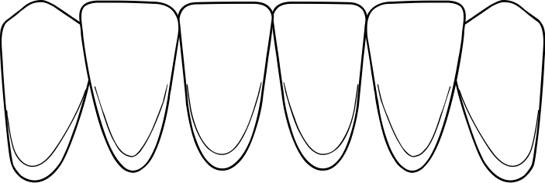
CEJ Located
Intra-oral retracted picture

Slide 39
Tooth Color
Tooth Color
Intra-oral retracted teeth with shade tab

Slide 40
Tooth Alignment
Tooth Alignment
(Spacing, Overlapping)
Intra-oral retracted teeth apart picture

Slide 41
CORE Questions
This is an instruction slide.
It will not be shown in the presentation.
 | CORE Values | Case Values | Abnormal
Facial Height? | 1:1 |  | ☑
Lip Length? | 20-22 mm Female 22-24 mm Male |  | ☑
Lip Mobility? | 6-8 mm |  | ☑
Gingival Line? | Straight |  | ☑
Tooth Length? | 10 mm |  | ☑
CEJ? | Yes |  | ☑
Notes:
Fill in the Case Values for the current case.
If the Case Value is within the range of the CORE Value, then delete the Abnormal check-box

Slide 42
CORE Questions
 | CORE Values | Case Values | Abnormal
Facial Height? | 1:1 |  | ☑
Lip Length? | 20-22 mm Female 22-24 mm Male |  | ☑
Lip Mobility? | 6-8 mm |  | ☑
Gingival Line? | Straight |  | ☑
Tooth Length? | 10 mm |  | ☑
CEJ? | Yes |  | ☑
Notes:

Slide 43
CORE “Global” Diagnoses
 | Abnormal | Case Values
Facial Height? | ☑ | Vertical Maxillary Excess
Lip Length? | ☑ | Lip Dimension Short or Long
Lip Mobility? | ☑ | Lip Hyperactive or Hypoactive
Gingival Line? | ☑ | Dentoalveolar Extrusion with Wear, without Wear, Canted
Tooth Length? | ☑ | Microdontia, Wear, Altered Passive Eruption
CEJ? | ☑ | Altered Passive Eruption
Notes:
This is an instruction slide.
It will not be shown in the presentation.
Delete the check-box for any questions which are normal
Complete the “Global” Diagnosis column by editing this with adding or deleting

Slide 44
CORE “Global” Diagnoses
 | Abnormal | Case Values
Facial Height? | ☑ | Vertical Maxillary Excess
Lip Length? | ☑ | Lip Dimension Short or Long
Lip Mobility? | ☑ | Lip Hyperactive or Hypoactive
Gingival Line? | ☑ | Dentoalveolar Extrusion with Wear, without Wear, Canted
Tooth Length? | ☑ | Microdontia, Wear, Altered Passive Eruption
CEJ? | ☑ | Altered Passive Eruption
Notes:

Slide 45
Imaging

Slide 46
Imaging

Slide 47
Models
NOTES

Slide 48
FM Radiograph
NOTES

Slide 49
Panoramic Radiograph
NOTES

Slide 50
CBCT
NOTES

Slide 51
MRI
NOTES

Slide 52
MRI
NOTES

Slide 53
MRI
NOTES

Slide 54
MRI
NOTES

Slide 55
Global Occlusal Findings
Stable TMJ Yes No
Anterior Guidance Yes No
Stable Vertical Dimension
Yes No
Non interfering posterior teeth
Yes No
Airway Positive/ Neutral /Negative

Slide 56
Global Occlusal Findings
Unstable TMJ:
Symptomatic /Asymptomatic
Muscle? Joint? Other structures
Joint:
Piper stage:
I II IIIa IIIb IVa IVb Va Vb
Risk: Red / Yellow / Green
Degenerative changes :
Active / Historic
Adaptive/ Maladaptive

Slide 57
Global Occlusal Findings
Unstable TMJ:
2mm Rule :
Overjet : > < 2mm
Open Bite: > < 2mm
Class II: > < 2mm R/L/Both
FSCP to MI > < 2mm

Slide 58
Global Occlusal Findings
Adaptive findings:
Growth limitations/disproportion
Tooth Migration
Tooth Intrusion
Maladaptive findings:
Wear
Cracking
Fracture
Tooth loss

Slide 59
Global Occlusal Findings
Pain origins:
Muscle Yes/ No
Joint Yes/ No
Neuropathic Yes/ No
Referred Yes/No
Central/behavioral Yes/No

Slide 60
Global Airway Findings
Mallampatti I II III IV
Nasal Stenosis Yes/ No
Internal/ External/ Both
Enlarged/ Inflamed turbinates
Septum Deviation Yes/No

Slide 61
Global Airway Findings
Scalloped Tongue Yes/ No
Tongue Ankylosis Yes/ No
Tonsil grade I II II IV V

Slide 62
Global Occlusal Findings
Additional notes or observations

Slide 63
“Regional” Findings
Pathosis
Intra-oral –
Extra-oral –

Slide 64
“Regional” Findings
Periodontal

Slide 65
Periodontal Chart

Slide 66
“Regional” Findings
Biomechanics
Caries –

Slide 67
“Regional” Findings
Biomechanics
Restorations and
tooth integrity –
(craze lines, fractures, erosion, attrition)

Slide 68
“Regional” Findings
Biomechanics
Endodontic –

Slide 69
Specialty Findings

Slide 70
Problem List

Slide 71
Sequential Treatment Plan

Slide 72
Supplemental Photos

Slide 73
Supplemental Photos

Slide 74
Supplemental Photos

